Slide 1


Digital Transmission

Slide 2






4-1 DIGITAL-TO-DIGITAL CONVERSION
Topics discussed in this section:
Line Coding
Line Coding Schemes
Block Coding
Scrambling
Notes:
In this section, we see how we can represent digital data by using digital signals

Slide 3
Line Coding
Converting a string of 1‟s and 0‟s (digital data) into a sequence of signals
denote the 1‟s and 0‟s.
Example high voltage level (+V) could represent a “1”
low voltage level (0 or -V) could represent a “0”.
Notes:
Converting a string of 1‟s and 0‟s (digital data) into a sequence of signals that denote the 1‟s and 0‟s.
For example a high voltage level (+V) could represent a “1” and a low voltage level (0 or -V) could represent a “0”.

Slide 4
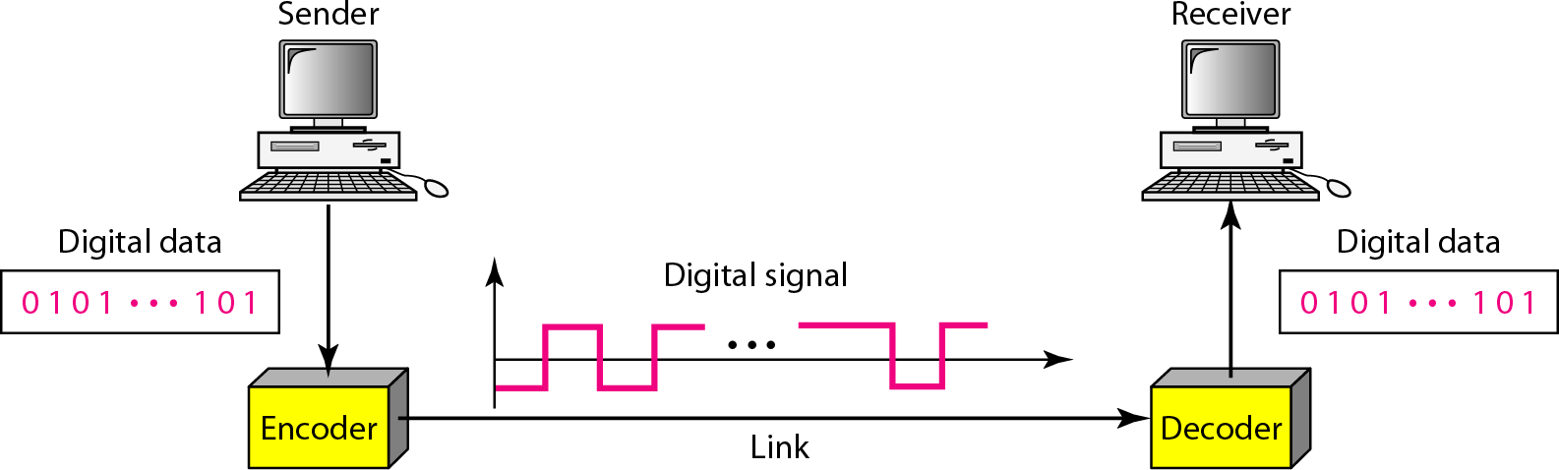
Figure 4.1 Line coding and decoding

Slide 5
Mapping Data symbols onto Signal levels
A data symbol (or element) can consist of a number of data bits:
1 , 0 or
11, 10, 01, ……

Slide 6
Mapping Data symbols onto Signal levels
Data symbol can be coded into a single signal element.
Data symbol can be coded into multiple signal element.
1 -> +V, 0 -> -V
1 -> +V and -V, 0 -> -V and +V

Slide 7
Mapping Data symbols onto Signal levels
The ratio „r‟ is the number of data elements carried by a signal element.

Slide 8
Relationship between data rate and signal rate
Data rate :
Defines the number of bits sent per sec - bps.
Data rate is often referred to the bit rate.
Signal rate :
Number of signal elements sent in a second.
Signal Rate is measured in bauds.

Slide 9
Relationship between data rate and signal rate
Bauds is also referred to as the modulation rate.
Goal is to increase the data rate whilst reducing the baud rate.

Slide 10
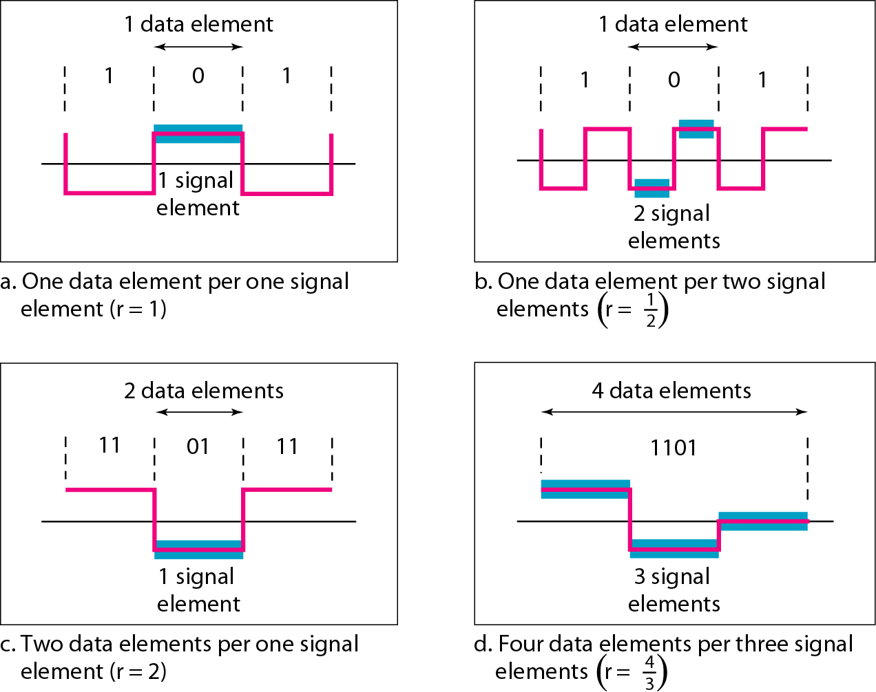
Figure 4.2 Signal element versus data element

Slide 11
Data rate and Baud rate
The baud or signal rate can be expressed as:
S = c x N x 1/r bauds where N is data rate
c is the case factor (worst, best & avg.)
r is the ratio between data element &
signal element

Slide 12



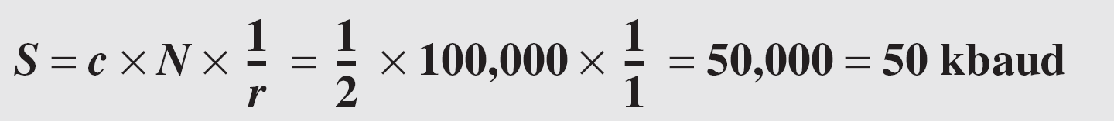
Example 4.1
A signal is carrying data in which one data element is encoded as one signal element ( r = 1). If the bit rate is 100 kbps, what is the average value of the baud rate if c is between 0 and 1?
Solution
We assume that the average value of c is 1/2 . The baud rate is then

Slide 13
Considerations for choosing a good signal element referred to as line encoding.

Slide 14
Game 1: Baud Rate Bouncer 🕺
Only legends know the baud beats. Try to be the King of Bauds!
A signal carries 2 bits per symbol at a rate of 100 kbps.
What’s the baud rate?
A. 50 bauds
B. 200 bauds
C. 100 bauds
D. 25 bauds
Notes:
Correct Answer: A. 50 bauds
Justification:
Baud rate = Bit rate / bits per symbol = 100 kbps / 2 = 50 bauds.

Slide 15
Line encoding C/Cs
DC components
When the voltage level remains constant for long periods of time
There is an increase in the low frequencies of the signal.
Notes:
DC components - when the voltage level remains constant for long periods of time, there is an increase in the low frequencies of the signal. Most channels are bandpass and may not support the low frequencies.
This will require the removal of the dc component of a transmitted signal.

Slide 16
Line encoding C/Cs
This will require the removal of the dc component of a transmitted signal.
Notes:
DC components - when the voltage level remains constant for long periods of time, there is an increase in the low frequencies of the signal. Most channels are bandpass and may not support the low frequencies.
This will require the removal of the dc component of a transmitted signal.

Slide 17
Line encoding C/Cs
Self synchronization
The clocks at the sender and the receiver must have the same bit interval.

Slide 18
Line encoding C/Cs
Self synchronization
When receiver clock is faster or slower it
will misinterpret the incoming bit stream.

Slide 19
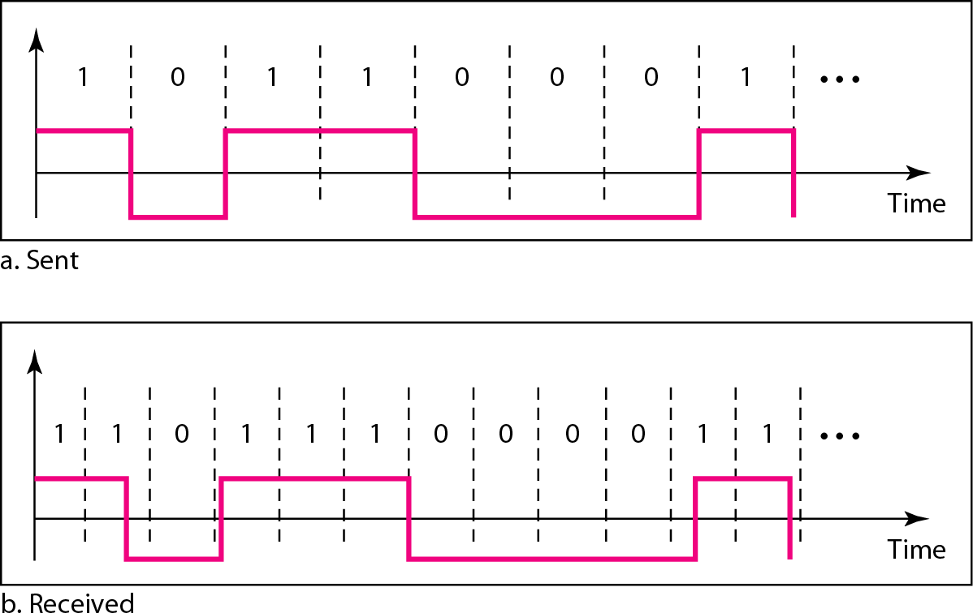
Figure 4.3 Effect of lack of synchronization

Slide 20
Example 4.3
In a digital transmission, the receiver clock is 0.1 percent faster than the sender clock. How many extra bits per second does the receiver receive if the data rate is 1 kbps? How many if the data rate is 1 Mbps?
Solution
At 1 kbps, the receiver receives 1001 bps instead of 1000 bps.
At 1 Mbps, the receiver receives 1,001,000 bps instead of 1,000,000 bps.

Slide 21
Line encoding C/Cs
Error detection –
Error occur during transmission due to line impairments.
Some codes are constructed to detect error when occurs.

Slide 22
Line encoding C/Cs
For example:
Particular signal transition is not part of the code.
When it occurs, the receiver will know that a symbol error has occurred.

Slide 23
Line encoding C/Cs
Noise and interference –
Line encoding techniques that make the transmitted signal “immune” to noise and interference.
.
Notes:
is means that the signal cannot be corrupted, it is stronger than error detection.

Slide 24
Line encoding C/Cs
Complexity
The more robust and resilient the code
More complex to implement
Price is often more than simple one.

Slide 25
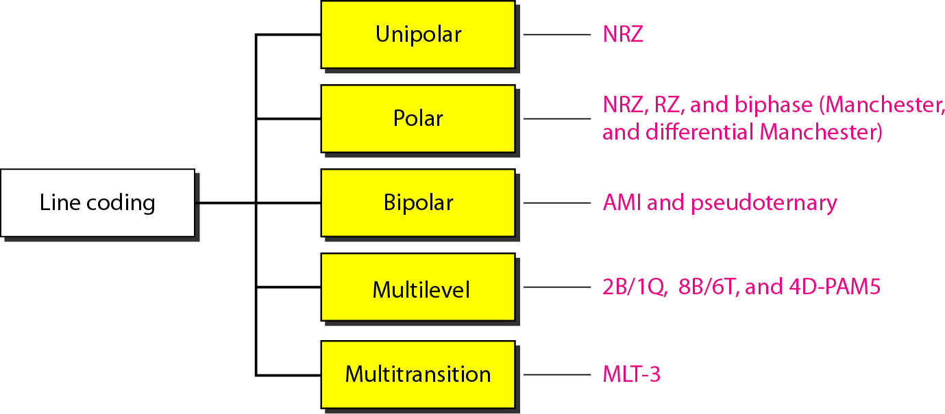
Figure 4.4 Line coding schemes

Slide 26
Unipolar
All signal levels are on one side of the time axis –
either above or below

Slide 27
Unipolar
NRZ
Non Return to Zero scheme
Signal level does not return to zero
during a symbol transmission.

Slide 28
Unipolar
NRZ
Scheme is prone to DC components.
No synchronization
No error detection.
Simple but costly in power consumption.

Slide 29
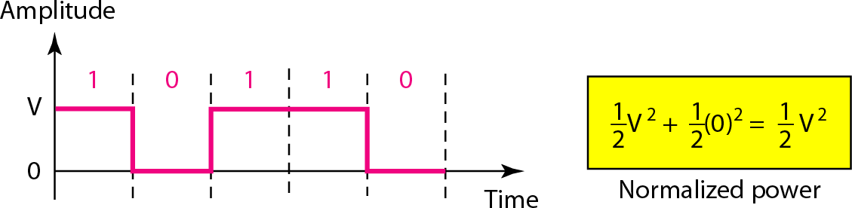
Figure 4.5 Unipolar NRZ scheme

Slide 30
Polar - NRZ
Voltages are on both sides of the time axis.
Polar NRZ scheme can be implemented with two voltages.
E.g. +V for 1 and -V for 0.

Slide 31
Polar - NRZ
There are two versions:
1. NZR - Level (NRZ-L)
positive voltage for one symbol
negative for the other

Slide 32
Polar - NRZ
There are two versions:
2. NRZ - Inversion (NRZ-I)
change or lack of change in polarity determines the value of a symbol.
E.g. a “1” symbol inverts the polarity a “0”
does not.

Slide 33
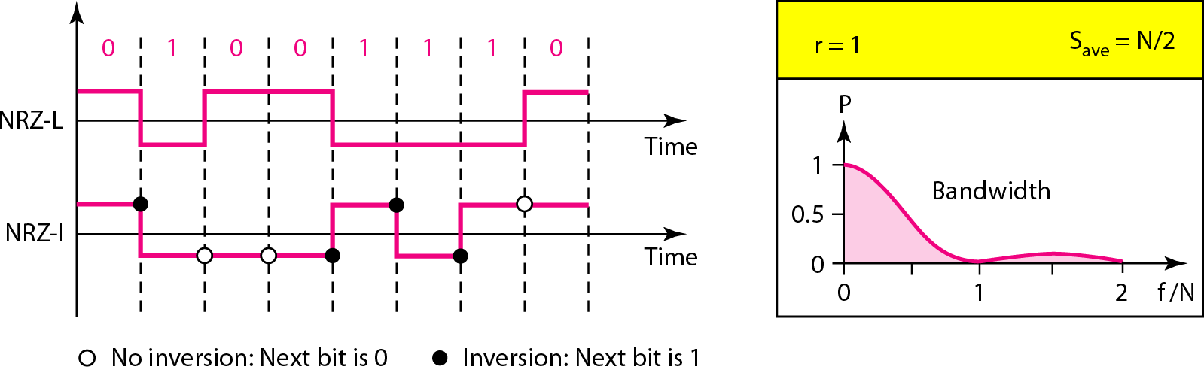
Figure 4.6 Polar NRZ-L and NRZ-I schemes

Slide 34
In NRZ-L the level of the voltage determines the value of the bit.
In NRZ-I the inversion or the lack of inversion determines the value of the bit
NRZ-L and NRZ-I both have an average signal rate of N/2 Bd.
Notes:
In NRZ-L the level of the voltage determines the value of the bit.
In NRZ-I the inversion or the lack of inversion
determines the value of the bit

Slide 35
NRZ-L and NRZ-I Both have no self synchronization &no error detection.
Both are relatively simple to implement.

Slide 36
Polar - RZ
The Return to Zero (RZ) scheme uses three voltage values. +, 0, -.
Each symbol has a transition in the middle.
Either from high to zero or from low to zero.

Slide 37
Polar - RZ
This scheme has more signal transitions (two per symbol) .
Therefore requires a wider bandwidth.
No DC components
Self synchronization - transition indicates symbol value.

Slide 38
Polar - RZ
More complex as it uses three voltage level.
It has no error detection capability.

Slide 39
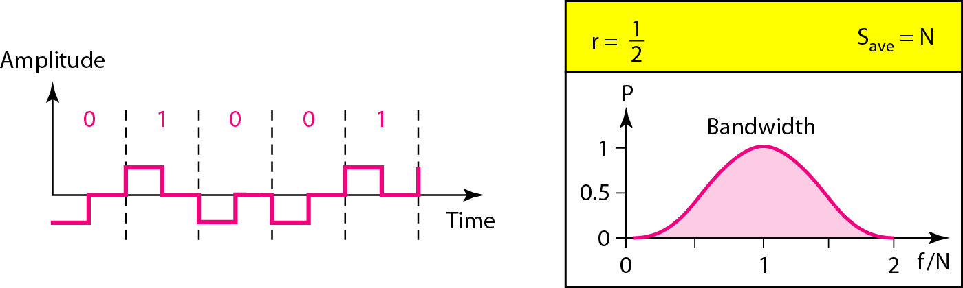
Figure 4.7 Polar RZ scheme

Slide 40
Polar - Biphase: Manchester and Differential Manchester
Manchester coding consists of combining the NRZ-L and RZ schemes.
Every symbol has a level transition in the middle:
:High to low or low to high.
Uses only two voltage levels.

Slide 41
Polar - Biphase: Manchester and Differential Manchester
Differential Manchester coding consists of combining the NRZ-I and RZ schemes.
Every symbol has a level transition in the middle.
But the level at the beginning of the symbol is determined by the symbol value.
One symbol causes a level change the other does not.

Slide 42
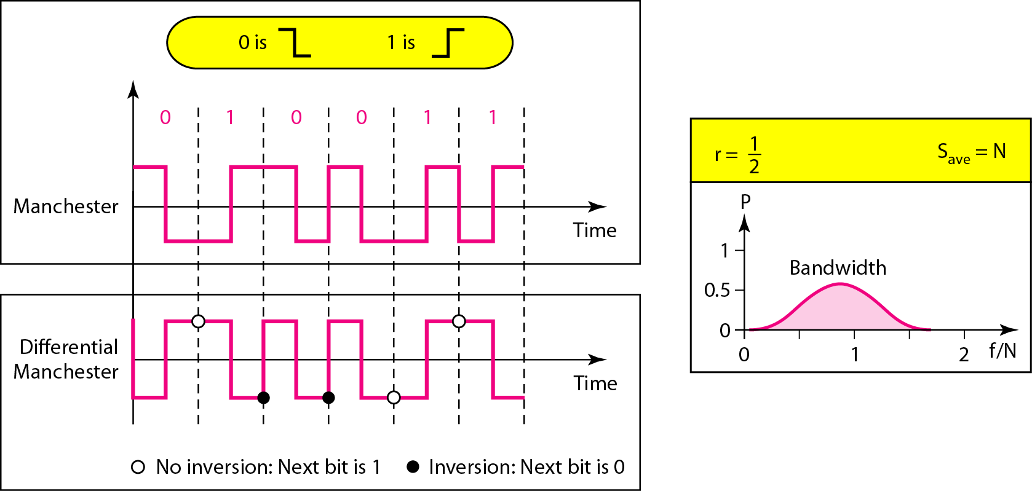
Figure 4.8 Polar biphase: Manchester and differential Manchester schemes

Slide 43
In Manchester and differential Manchester encoding:
Transition at the middle of the bit is used for synchronization.

Slide 44
Game 2: Coding Confession 😂
I’m a coding scheme with no chill — I flip in the middle of every bit! Who am I?
A. Unipolar NRZ
B. NRZ-I
C. Manchester
D. Differential Manchester
Notes:
Correct Answer: C. Manchester
Justification:
Manchester coding has a transition in the middle of every bit: high-to-low for '1', low-to-high for '0'. It's a combo of NRZ-L and RZ. Great for sync, bad for bandwidth!

